Slide 1

Temporal and Behavioral Factors Driving Song Skip Predictions in Personal Spotify Streaming Data
Xavier P. Pagdanganan
CCIT - National University Philippines

Slide 2
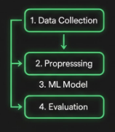
Introduction & Motivation
  The Quantified Self: Tracking digital habits.
  Problem: Identifying patterns in skip behavior.
  Objectives: Collect, analyze, and predict.
  Scope: Two-month personal listening history.
Data Science Workflow

Slide 3
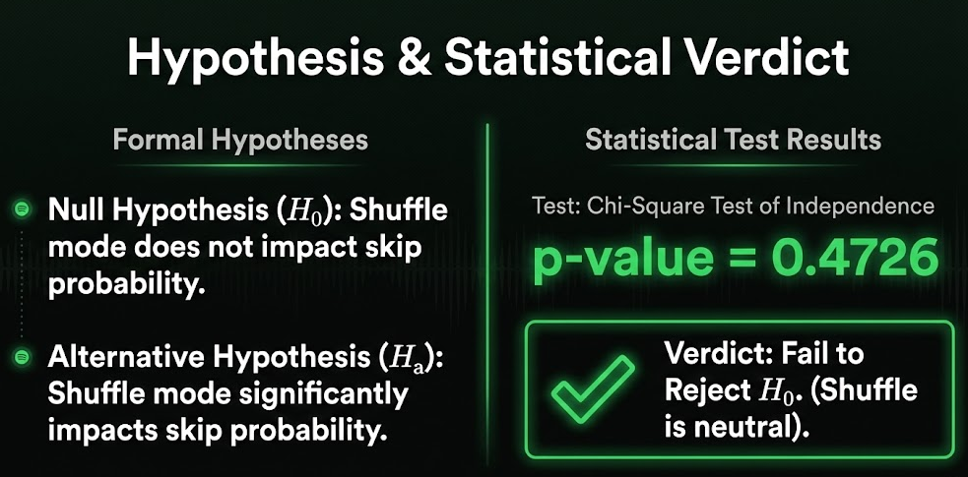

Slide 4

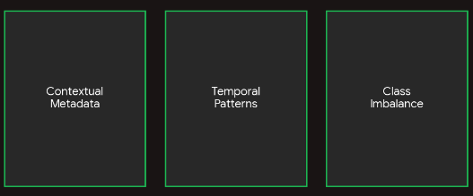

Slide 5

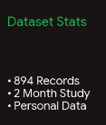
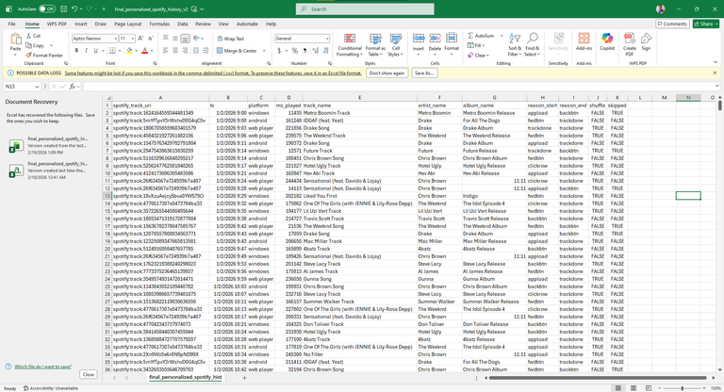
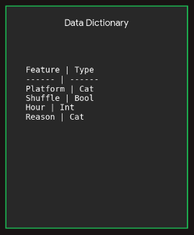

Slide 6
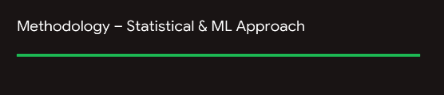
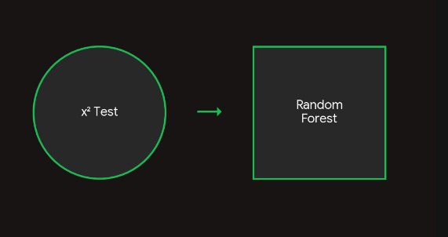

Slide 7
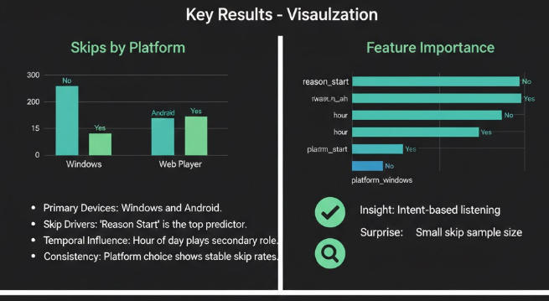

Slide 8
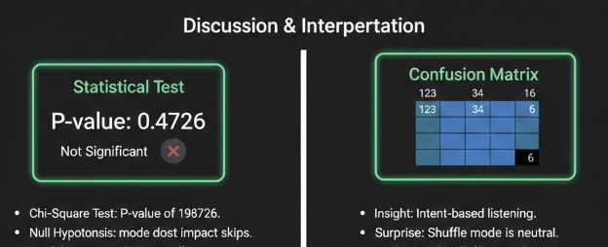
  Model: 72% overall.
  Class Imbalance: High precision for plays.
  Limitation: Small skip sample size
  Conclusion: Context predicts engagement.

Slide 9
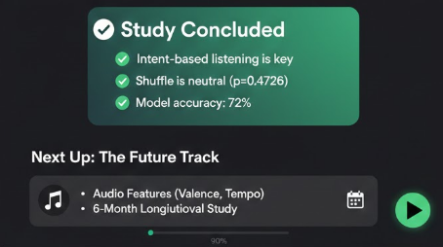
Longitudinal Study

Slide 10
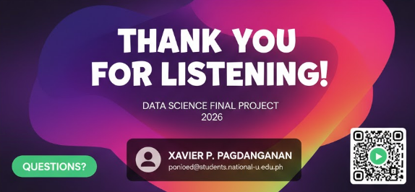
pagdangananxp@students.national-u.edu.ph

